Slide 1







Pioneering Mars:
Turning the Red Planet Green
ST STAN
BAKER
Growing
Cyanobacteria
in the Lab
Scott P. Milroy, Ph.D.
USM Department of Marine Science
14-19 November 2012

Slide 2


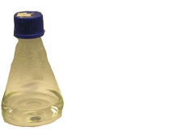
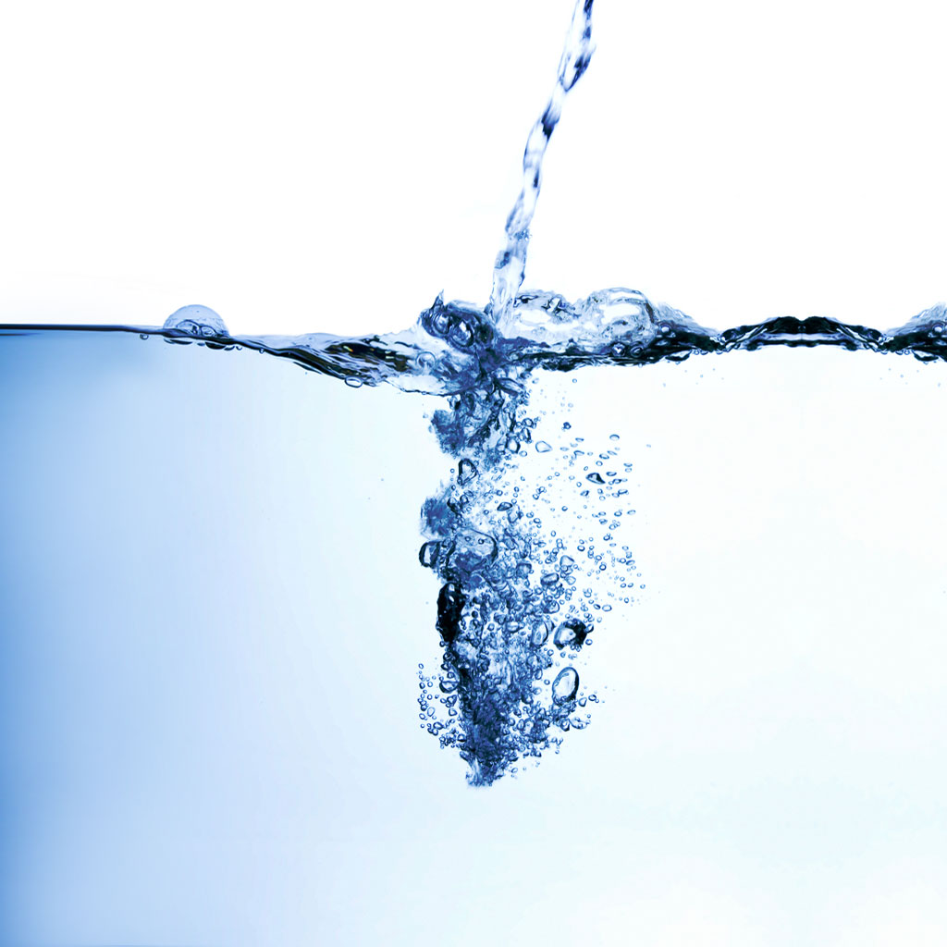
Pioneering Mars
The Basics of Algal Culture
Several growth chambers (flasks) are prepared with liquid growth media, which contains:
Ultrapure Water

Slide 3
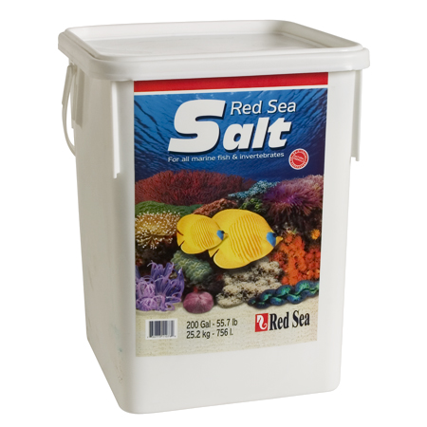
Pioneering Mars
The Basics of Algal Culture
Several growth chambers (flasks) are prepared with liquid growth media, which contains:
Sea Salts
Ultrapure Water

Slide 4

Pioneering Mars
The Basics of Algal Culture
Several growth chambers (flasks) are prepared with liquid growth media, which contains:
Sea Salts
Vitamins

Slide 5
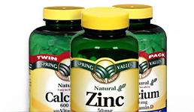
Pioneering Mars
The Basics of Algal Culture
Several growth chambers (flasks) are prepared with liquid growth media, which contains:
Minerals
Vitamins

Slide 6


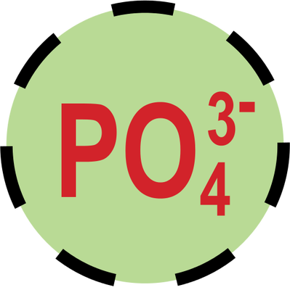
Pioneering Mars
The Basics of Algal Culture
Several growth chambers (flasks) are prepared with liquid growth media, which contains:
Minerals
Nutrients

Slide 7
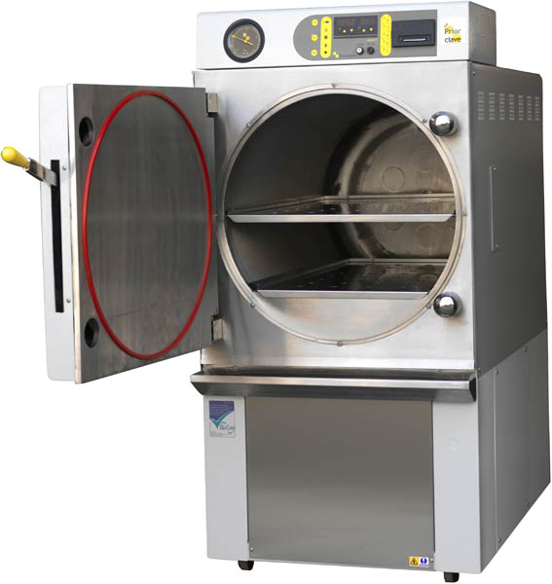
Pioneering Mars
The Basics of Algal Culture
Several growth chambers (flasks) are prepared with liquid growth media, which contains:
The flasks and growth media must then be sterilized to prevent bacterial or fungal contamination (i.e. “axenic” cultures)…
Nutrients

Slide 8
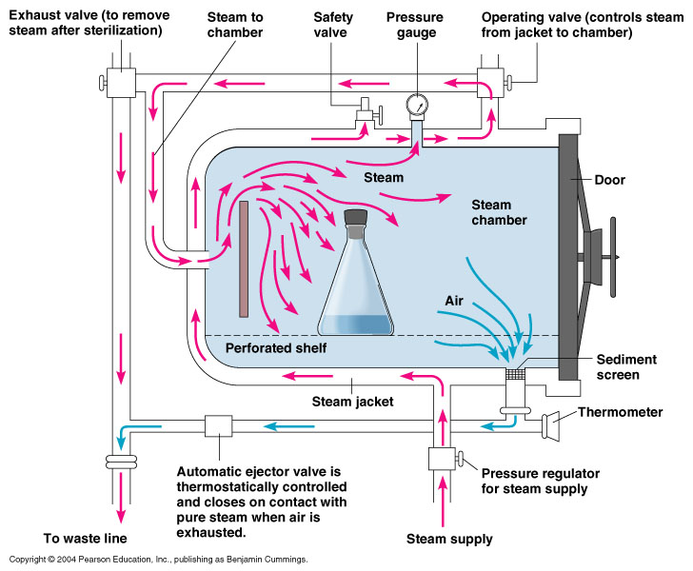
Pioneering Mars
The Basics of Algal Culture
The flasks and growth media must then be sterilized to prevent contamination…
The high pressure and steam within the autoclave is an effective way to sterilize delicate equipment, flasks, and growth media.

Slide 9
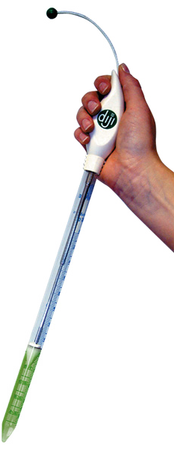
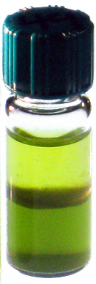
Pioneering Mars
The Basics of Algal Culture
The high pressure and steam within the autoclave is an effective way to sterilize delicate equipment, flasks, and growth media.
The sterile growth media can now be inoculated with a small volume from the “parent” culture

Slide 10
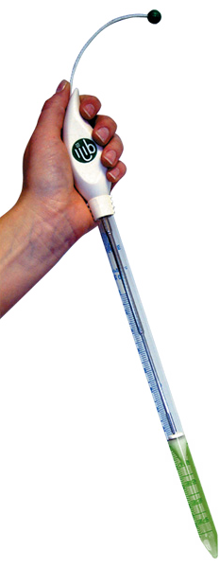
Pioneering Mars
The Basics of Algal Culture
The sterile growth media can now be inoculated with a small volume from the “parent” culture

Slide 11
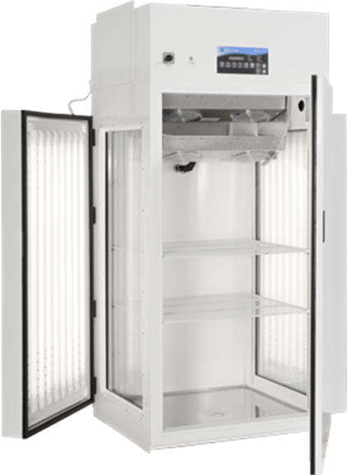
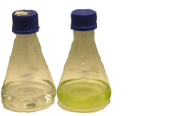
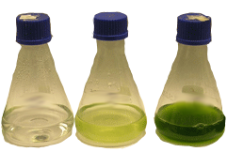
Pioneering Mars
The Basics of Algal Culture
The sterile growth media can now be inoculated with a small volume from the “parent” culture
The “daughter” cultures are then placed in a light- and temperature-controlled incubator and allowed to grow…

Slide 12
Pioneering Mars
The Basics of Algal Culture
Algal cultures are typically run either as a BATCH culture or as a CONTINUOUS culture…
BATCH
CONTINUOUS

Slide 13

Pioneering Mars
The Basics of Algal Culture
Algal cultures are typically run either as a BATCH culture or as a CONTINUOUS culture…
Because we need small, portable, sealed growth chambers, it makes the most sense for us to use BATCH cultures for our experiments…
BATCH
CONTINUOUS

Slide 14
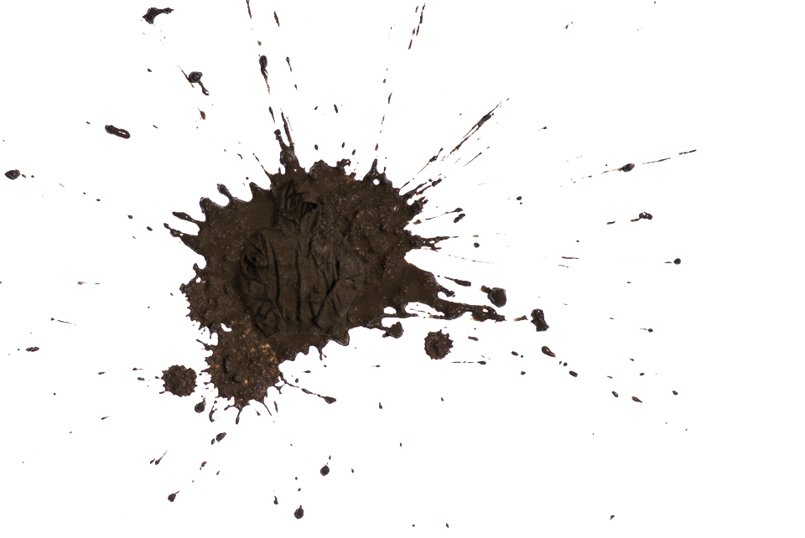
Pioneering Mars
Things to Think About
During our workshop, we’ll determine the fundamental parameters of our culture experiments, such as:
Because we need small, portable, sealed growth chambers, it makes the most sense for us to use BATCH cultures for our experiments…
BATCH
◊ Type & Concentration of Dissolved Salts?
(Best representation of wet Martian soils)

Slide 15
Pioneering Mars
Things to Think About
During our workshop, we’ll determine the fundamental parameters of our culture experiments, such as:
◊ Type & Concentration of Dissolved Salts?
(Best representation of wet Martian soils)
◊ Vitamins, Minerals, and/or Nutrients?
(Ideal culture conditions vs Martian reality)

Slide 16
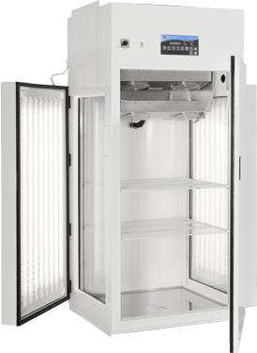
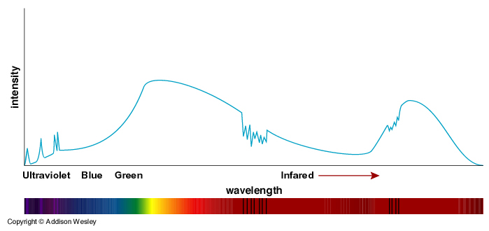
Pioneering Mars
Things to Think About
During our workshop, we’ll determine the fundamental parameters of our culture experiments, such as:
◊ Type & Concentration of Dissolved Salts?
(Best representation of wet Martian soils)
◊ Vitamins, Minerals, and/or Nutrients?
(Ideal culture conditions vs Martian reality)
◊ UV/Visible Light Quality & Quantity?
(Irradiance vs Photoperiod on Martian surface)

Slide 17
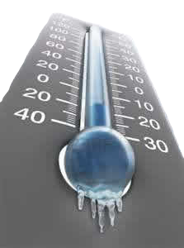
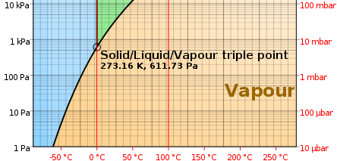
Pioneering Mars
Things to Think About
During our workshop, we’ll determine the fundamental parameters of our culture experiments, such as:
◊ Type & Concentration of Dissolved Salts?
(Best representation of wet Martian soils)
◊ Vitamins, Minerals, and/or Nutrients?
(Ideal culture conditions vs Martian reality)
◊ UV/Visible Light Quality & Quantity?
(Irradiance vs Photoperiod on Martian surface)
◊ Pressure and Temperature Consequences?
(Freeze/Thaw Survival & H₂O Triple-point)

Slide 18
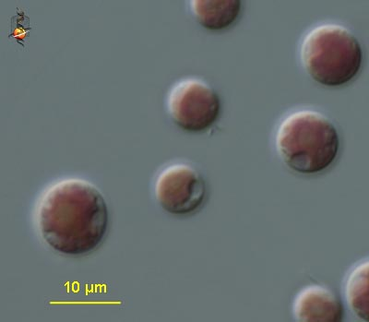
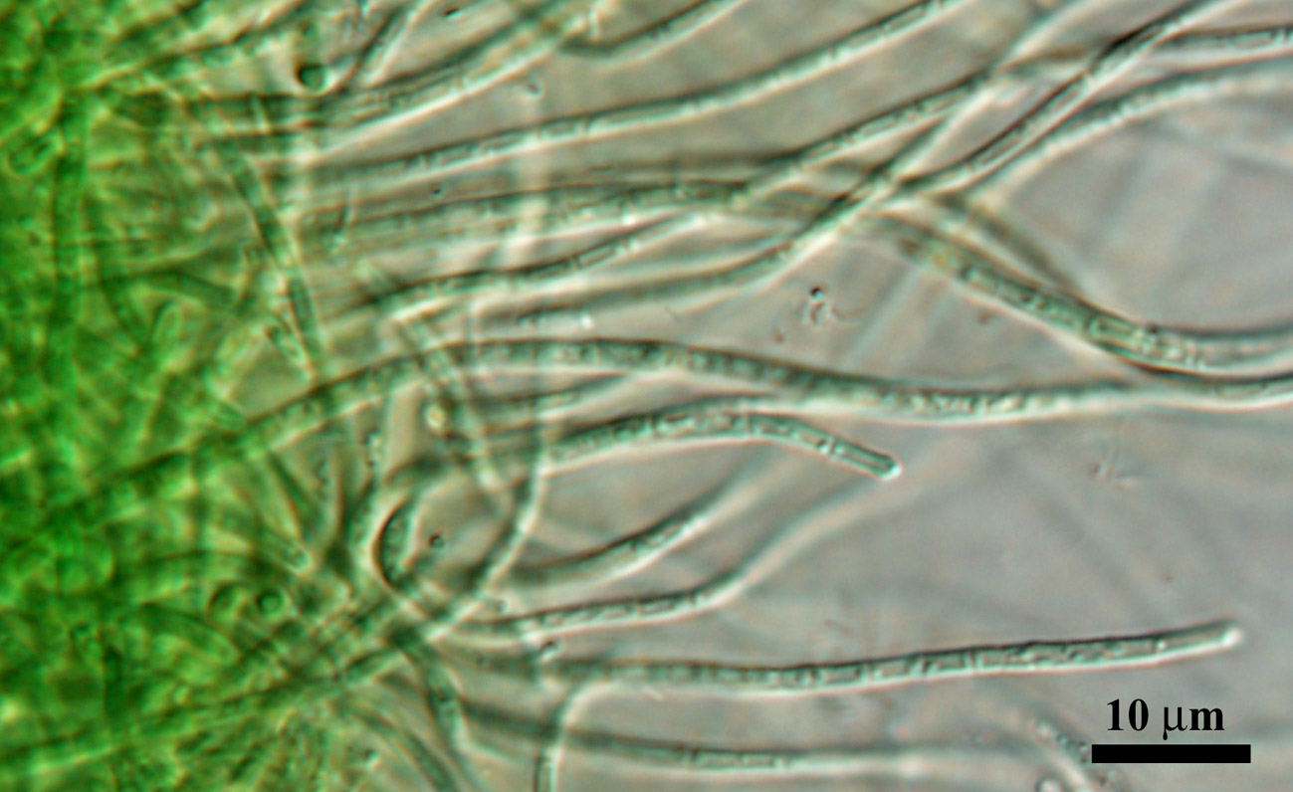
Pioneering Mars
Things to Think About
During our workshop, we’ll determine the fundamental parameters of our culture experiments, such as:
◊ Type & Concentration of Dissolved Salts?
(Best representation of wet Martian soils)
◊ Vitamins, Minerals, and/or Nutrients?
(Ideal culture conditions vs Martian reality)
◊ UV/Visible Light Quality & Quantity?
(Irradiance vs Photoperiod on Martian surface)
◊ Pressure and Temperature Consequences?
(Freeze/Thaw Survival & H₂O Triple-point)
◊ Cyanobacteria vs Other Extremeophiles?
(Perhaps there are other options - rhodophytes?)

